Slide 1
The Public
Prequel
ENVE 644
Class 11

Slide 2
Permits and the Public
Many planning actions and most
Permit Actions
Mandate a public involvement process
But even if not mandated, for example
The FHWA (DOT) CatEx say for
A bikepath in an existing ROW
Social Impacts
Will affect neighborhoods or community cohesion?
All it takes is a few letters or phone calls to trigger an investigation of public reaction.

Slide 3
Public Meetings
Collage of public meetings from Parks and Rec
https://www.youtube.com/watch?v=In9oSjjltOs
Who holds meetings?
Agency always required to inform public
Agency usually required to accept public input
Agency often required to hold public meetings
Applicant may hold meetings if public interest is high
Sophisticated applicant with always have a public information plan
Often have meetings

Slide 4
Risk Communications
Public usually trusts engineers and scientists
But not if they work for the government, industry, or environmental consultants
Hey, that’s us!
In situations of high concern and low trust – special communications techniques are needed.
We call these “Risk Communications”

Slide 5
Sandman
Peter Sandman is the grugru of risk communications
Here is the first of five parts of a Sandman video
That will get us started, last slide has more on Sandman, but not needed here
https://vimeo.com/35425564

Slide 6
Risk = Hazard + Outrage
(Sandman’s nomenclature)
Risk, the danger the public perceives
Hazard, the danger you compute [in engineer speak, the “real” hazard]
Outrage?

Slide 7
Sandman’s Outrage

Slide 8
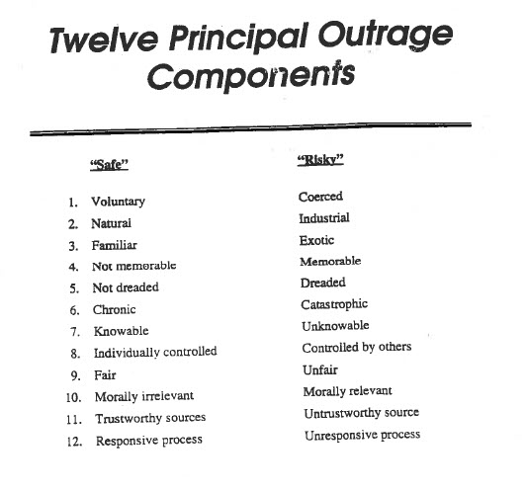

Slide 9
Take Home Ideas
When dealing with the public, what they are upset about may not relate to your computations.
Do not try to explain to the public why they are wrong.
Try to determine the source of their outrage
Work on the outrage, not your computations

Slide 10
ADEC
The ADEC produced the Guidance on Public Involvement for Project Managers in 1999. It was written for their contaminated sites program. It is a draft that never went final, as far a I know.
Part III, starting on page 13, has a “toolkit” of public involvement tools and activities, ending on page 20. Please glance at those.
Written in 1999, it did not have social media, which would be very important today.
A much more recent document, RISK ASSESSMENT PROCEDURES MANUAL, FEBRUARY 1, 2018, has a very short section on the public, bottom of page 3 and a little of page 4. It just says the department (ADEC) will decide the best method of participation.

Slide 11
Take home (or bring to class)
Having picked up on the concept of risk communications, you know:
If the public believes the hazards are large
And the public does not trust the presenter
Special techniques are needed – caution
Plan for pubic interaction

Slide 12
Assignment
You work for the ADOT and need to shut the University Ave. bridge down for the summer.
But only two weeks, really,
The rest of the time there will be a temporary bridge,
And there are two alternate routes
The Coast Guard has decided to hold a public meeting before they authorize the bridge
Public wants ADOT to wait until winter so fishing and boating are not impacted.
Look over Toolkit and decide on tools you could use before the meeting
Look over Sandman’s components of outrage – which of these might be important?

Slide 13
More Sandman, but not needed for 644
https://vimeo.com/35425912
https://vimeo.com/35425987
https://vimeo.com/35426711
https://vimeo.com/35426781
Also, http://www.psandman.com/

